Slide 1
Теория Информации
В.Н. Ярмолик
Лекция 11
2017

Slide 2
Public Key Cryptosystems
Exponentiation Ciphers
In 1978, Pohling and Hellman published an encryption scheme based on computing exponentials over a finite field. At about the same time, Riverst, Shamir and Adleman published a similar scheme, but with a slight twist - a twist that gave the MIT group a method for realizing public-key encryption as put forth by Deffie and Hellman.
The Pohling-Hellman and RSA schemes both encipher a message block M=0,1,...,n-1 by computing the exponential
C=Me mod n,
where e and n are the key to the enciphering transformation. M is restored by the same operation, but using a different exponent d for the key:
M=C^{d} mod n.
Enciphering and deciphering can be implemented using the fast exponentiation algorithm shown earlier, so C=fastexp(M,e,n) and M=fastexp(C,d,n).

Slide 3
Public Key Cryptosystems
Exponentiation Ciphers
The enciphering and deciphering transformations are based on Euler’s generalization of Fermat’s Theorem, which states that for every M relatively prime to n:
M^{φ(n)} mod n = 1.
This property implies that if e and d satisfy the relation
ed =1 mod φ(n),
then deciphering restores the original plaintext message. This result is proved in the following theorem:

Slide 4
Public Key Cryptosystems
Exponentiation Ciphers
Theorem. Given e and d satisfying ed mod φ(n)=1 and a message M=0,1,...,n-1 such that gcd(M,n)=1, then
(Me mod n)^{d} mod n=M.
Proof: We have
(Me mod n)^{d} mod n=M^{ed} mod n.
Now, ed mod φ(n)=1 implies that ed = tφ(n)+1 for some integer t.
Thus,
M^{ed} mod n=M^{tφ(n)+1} mod n=MM^{tφ(n)} mod n=M(M^{tφ(n)} mod n) mod n =
=M(M^{φ(n)} mod n)^{t} mod n= M1^{t} mod n = M.
By symmetry, enciphering and deciphering are commutative and mutual inverses; thus,
(M^{d} mod n)^{e} mod n=Mde mod n = M.

Slide 5
Public Key Cryptosystems
Exponentiation Ciphers
Given φ(n), it is easy to generate a pair (e,d) satisfying ed mod φ(n)=1. This is done by first choosing d relatively prime φ(n), and then using the extended version of Euclid’s algorithm to compute its inverse:
e=inv(d,φ(n)).
Because e and d are symmetric, we could also pick e and compute d=inv(e,φ(n)).
In the Pohlig-Hellman Sheme, the modulus n is chosen to be large prime p. The enciphering and deciphering functions are thus given by
C=Me mod p
M=C^{d} mod p,
where all arithmetic is done in the Galois field GF(p). Because n=p is prime, φ(n) = p-1, which is trivially derived from p.Thus the scheme can be used for conventional encryption, where e and d are both kept secret.

Slide 6
Public Key Cryptosystems
Exponentiation Ciphers
Example. Let p=11, whence φ(p)=p-1=10. Choose d=7 and compute e=inv(7,10)=3. Suppose, M=5. Then M is enciphered as:
C=Me mod p=5³ mod 11=4.
Similarly, C is deciphered as:
M=C^{d} mod p=4⁷ mod 11=5.
The security of the scheme rests on the complexity of computing discrete logarithms in GF(p).

Slide 7
Public Key Cryptosystems
Riverst-Shamir-Adleman (RSA) Scheme
In the RSA scheme, the modulus n is the product of two large primes p and q:
n=pq.
Thus, φ(n)=(p-1)(q-1). The enciphering and deciphering functions are
C=Me mod n
M=C^{d} mod n,
Example. Let p=5, p=7 whence n=pq=35 and φ(n)=(5-1)(7-1)=24. Choose d=11. and compute e=inv(11,24)=11. Suppose, M=2. Then M is enciphered as:
C=Me mod p=2¹¹ mod 35=2048 mod 35 = 18.
and deciphering as:
M=C^{d} mod p=18¹¹ mod 35=2.

Slide 8
Public Key Cryptosystems
Riverst-Shamir-Adleman (RSA) Scheme
Example. Let p=53, p=61 whence n=pq=53×61=3233 and φ(n)=(53-1)(61-1)=3120. Letting d=791, we get e=71.
ed=791×71=1 mod 3120
To encipher the message M=RENAISSANCE, we break it into blocks of 2 digits each, where A=00, B=01,...,Z=25, and blank =26. We thus get
M = RE NA IS SA NC E
M=1704 1300 0818 1800 1302 0426
The first block is enciphered as 1704⁷¹=3106. The entire message is enciphered as
C=3106 0100 0931 2691 1984 2927.

Slide 9
Public Key Cryptosystems
Procedure RSA’s Key Generation
1. Select two random secret primes, p and q, where
a) p and q differ by a few digits;
b) both p-1 and q-1 should contain large prime factors;
c) gcd(p-1,q-1) should be small.
2. Compute the product n=pq, which is the public modulus, where p and q are randomly selected secret values.
3. Calculate Euler’s function, φ(n)=(p-1)(q-1), which is secret.
4. Select the key e or d, which is relatively prime to φ(n).
5. Calculate the multiplicative inverse of either d or e according to the equation ed mod φ(n)=1.

Slide 10
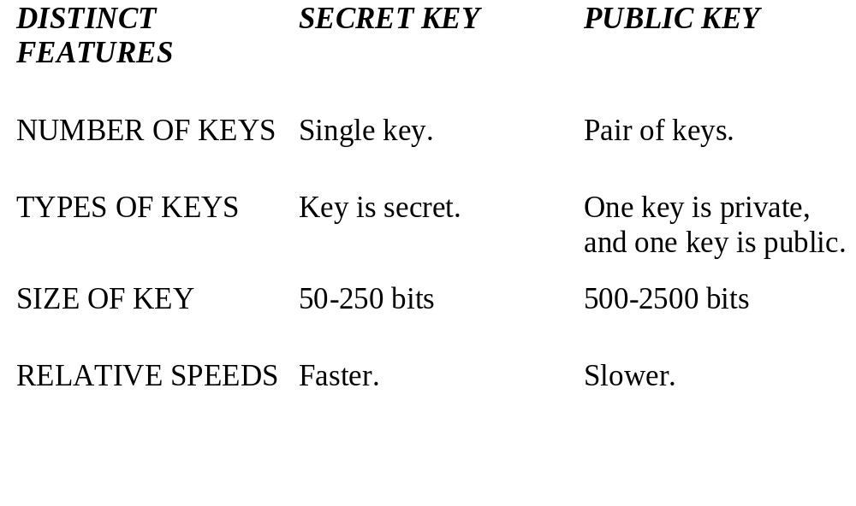
Public Key Cryptosystems
Comparison of Secret Key (SK) and Public Key (PK) cryptosystems

Slide 11
Public Key Cryptosystems
Application of Public Key (PK) cryptosystems
Three important application of public-key algorithms:
  Public-Key Distribution Schemes (PKDS) - where the scheme is used to securely exchange a single piece of information (whose value depends on the two parties, but cannot be set). This value is normally used as a session key for a private-key scheme.
  Signature Schemes - used to create a digital signature only, where the private-key signs (create) signatures, and the public-key verifies signatures.
  Public Key Schemes (PKS) - used for encryption, where the public-key encrypts messages, and the private-key decrypts messages.

